Slide 1
Mass Measurements
Lecture 2 – October 9, 2015
D. Lascar | Postdoctoral Fellow | TRIUMF

Slide 2
Outline
How do you relate time to mass?
How do you trap ions?
What is going on in a Penning trap?
Time of Flight conversion

Slide 3


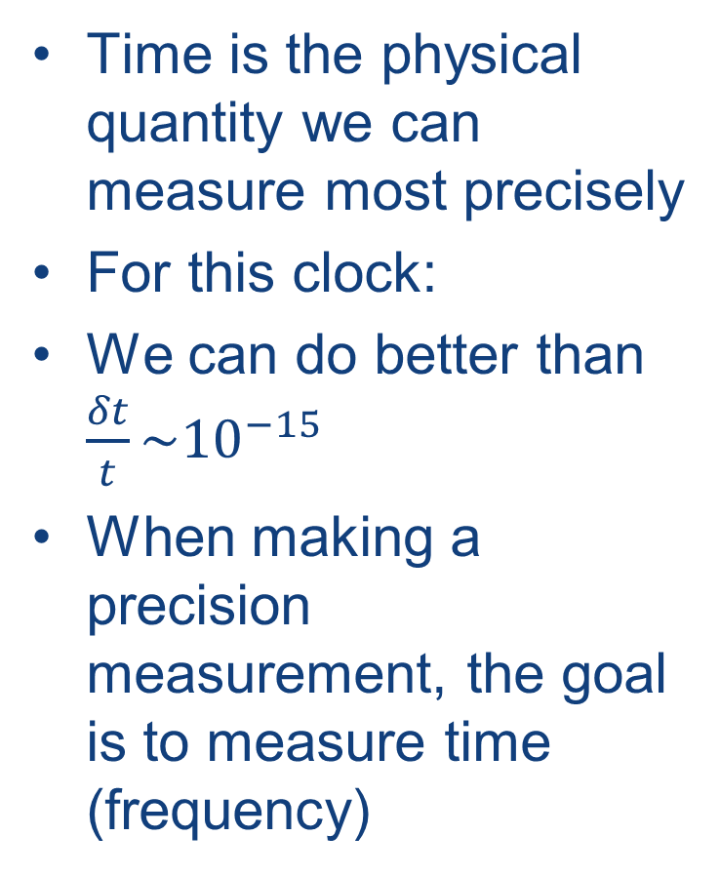
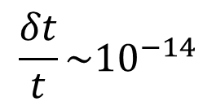
When last we left this…
Time is the physical quantity we can measure most precisely
For this clock:
We can do better than $\frac{δt}{t}\sim {10}^{−15}$
When making a precision measurement, the goal is to measure time (frequency)
$$\frac{δt}{t}\sim {10}^{−14}$$
For next class:
How can you relate a time (frequency) measurement to mass?
Notes:
1 second in 3 billion years

Slide 4
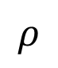
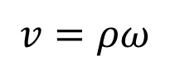
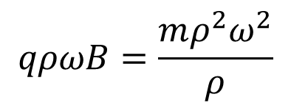
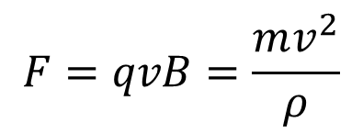
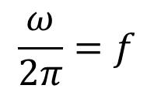
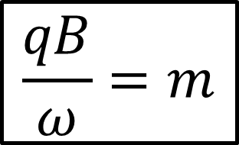
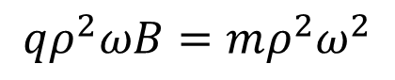
How do you relate time to mass?
Put it back in a magnetic field
This time for longer.
Long enough that it can complete multiple orbits.
$$F=qvB=\frac{mv^{2}}{ρ}$$
x x x x x x x x x x x x
+
x x x x x x x x x x x x
x x x x x x x x x x x x
$$\frac{ω}{2π}=f$$
x x x x x x x x x x x x
$$ρ$$
x x x x x x x x x x x x
x x x x x x x x x x x x
$$v=ρω$$
x x x x x x x x x x x x
$$qρωB=\frac{mρ^{2}ω^{2}}{ρ}$$
$$\frac{qB}{ω}=m$$
$$qρ^{2}ωB=mρ^{2}ω^{2}$$

Slide 5
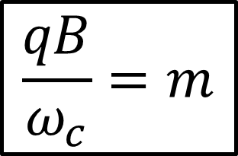
How do you relate time to mass?
Put it back in a magnetic field
This time for longer.
Long enough that it can complete multiple orbits.
$$F=qvB=\frac{mv^{2}}{ρ}$$
x x x x x x x x x x x x
+
x x x x x x x x x x x x
x x x x x x x x x x x x
$$\frac{ω}{2π}=f$$
x x x x x x x x x x x x
$$ρ$$
x x x x x x x x x x x x
x x x x x x x x x x x x
$$v=ρω$$
x x x x x x x x x x x x
$$qρωB=\frac{mρ^{2}ω^{2}}{ρ}$$
$$\frac{qB}{ω_{c}}=m$$
$$qρ^{2}ωB=mρ^{2}ω^{2}$$

Slide 6
How do you relate time to mass?
Put it back in a magnetic field
This time for longer.
Long enough that it can complete multiple orbits.
Can’t come in perpendicularly
Radius is a function of initial energy but you’ll never do better than a semicircle
How to get a full orbit?
x x x x x x x x x x x x
x x x x x x x x x x x x
x x x x x x x x x x x x
x x x x x x x x x x x x
x x x x x x x x x x x x
x x x x x x x x x x x x
x x x x x x x x x x x x
+

Slide 7
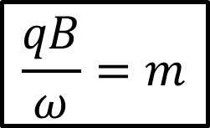
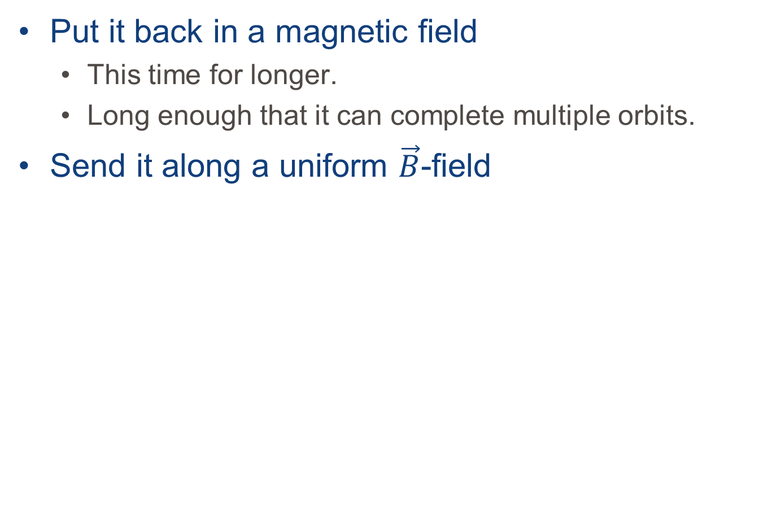
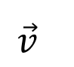
How do you relate time to mass?
$$\frac{qB}{ω}=m$$
Put it back in a magnetic field
This time for longer.
Long enough that it can complete multiple orbits.
Send it along a uniform $\vec{B}$-field
x x x x x x x x x x x x
+
x x x x x x x x x x x x
x x x x x x x x x x x x
Any perpendicular component will induce an oscillation
x x x x x x x x x x x x
x x x x x x x x x x x x
x x x x x x x x x x x x
x x x x x x x x x x x x
$$\vec{v}$$
+

Slide 8
What about the axial direction?
$$\frac{qB}{ω}=m$$
The ion will keep moving along.
Doesn’t give us much time to study it.
What should we do?
x x x x x x x x x x x x
+
x x x x x x x x x x x x
x x x x x x x x x x x x
x x x x x x x x x x x x
x x x x x x x x x x x x
x x x x x x x x x x x x
x x x x x x x x x x x x
+

Slide 9
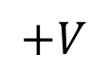
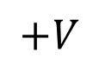
What about the axial direction?
$$\frac{qB}{ω}=m$$
Create a potential well.
All you need are a couple of electrodes
x x x x x x x x x x x x
+
x x x x x x x x x x x x
x x x x x x x x x x x x
x x x x x x x x x x x x
x x x x x x x x x x x x
x x x x x x x x x x x x
x x x x x x x x x x x x
$$+V$$
$$+V$$
+

Slide 10
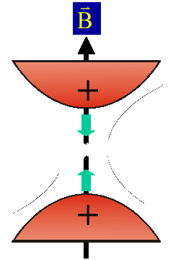



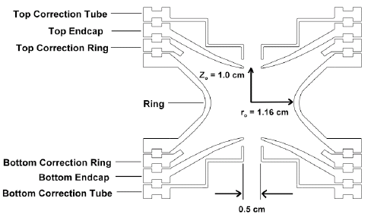
A Penning Trap
Electrodes create an axial quadrupole trapping potential
The potential repels in the radial direction but B takes care of that
Quadrupole potential created by making the electrodes conform to 2 hyperboloids of revolution.
Notes:
Point out that potential repels in the radial direction. It’s important later next slide.
Plus correction electrodes to account for finite extent of the hyperboloids and for the apertures.
Explain what a quadrupole potential is.
X² potential.
Simple harmonic oscillator
We know how to solve it

Slide 11
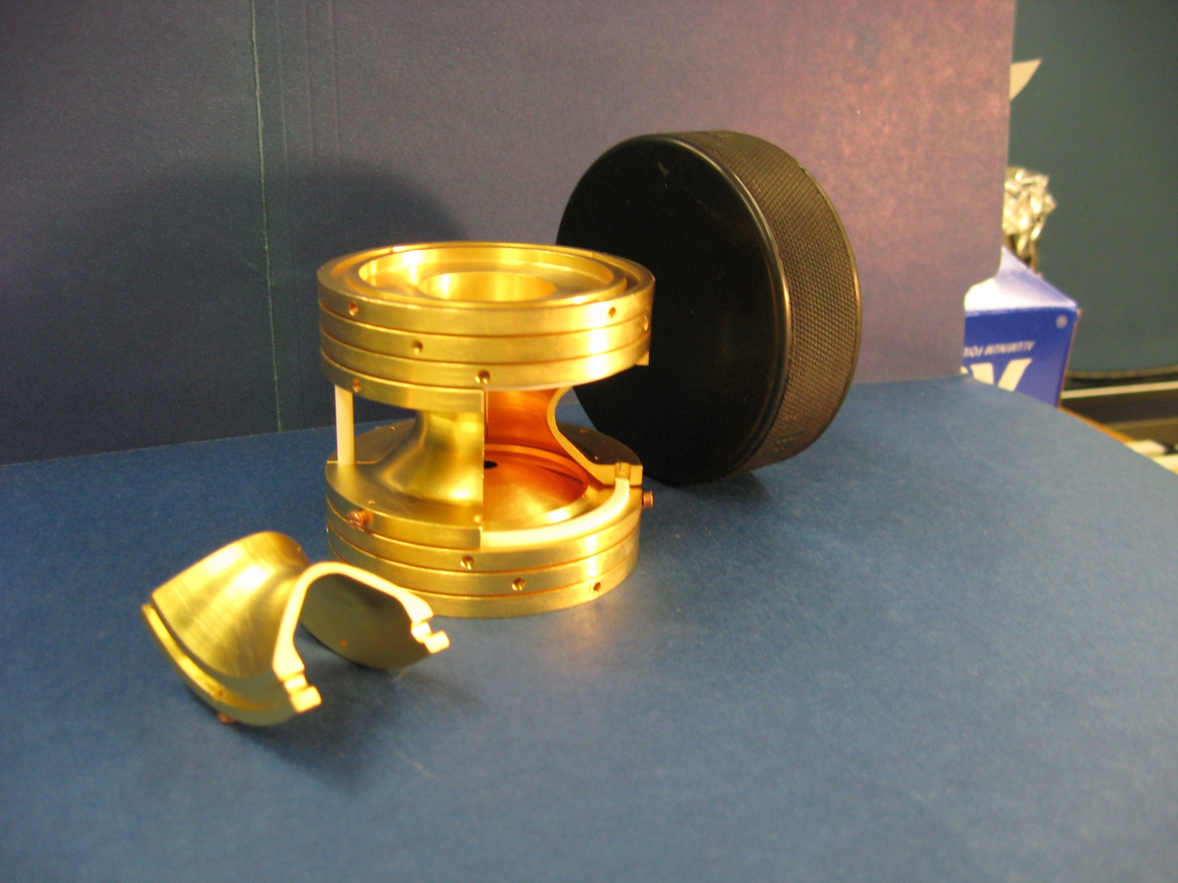
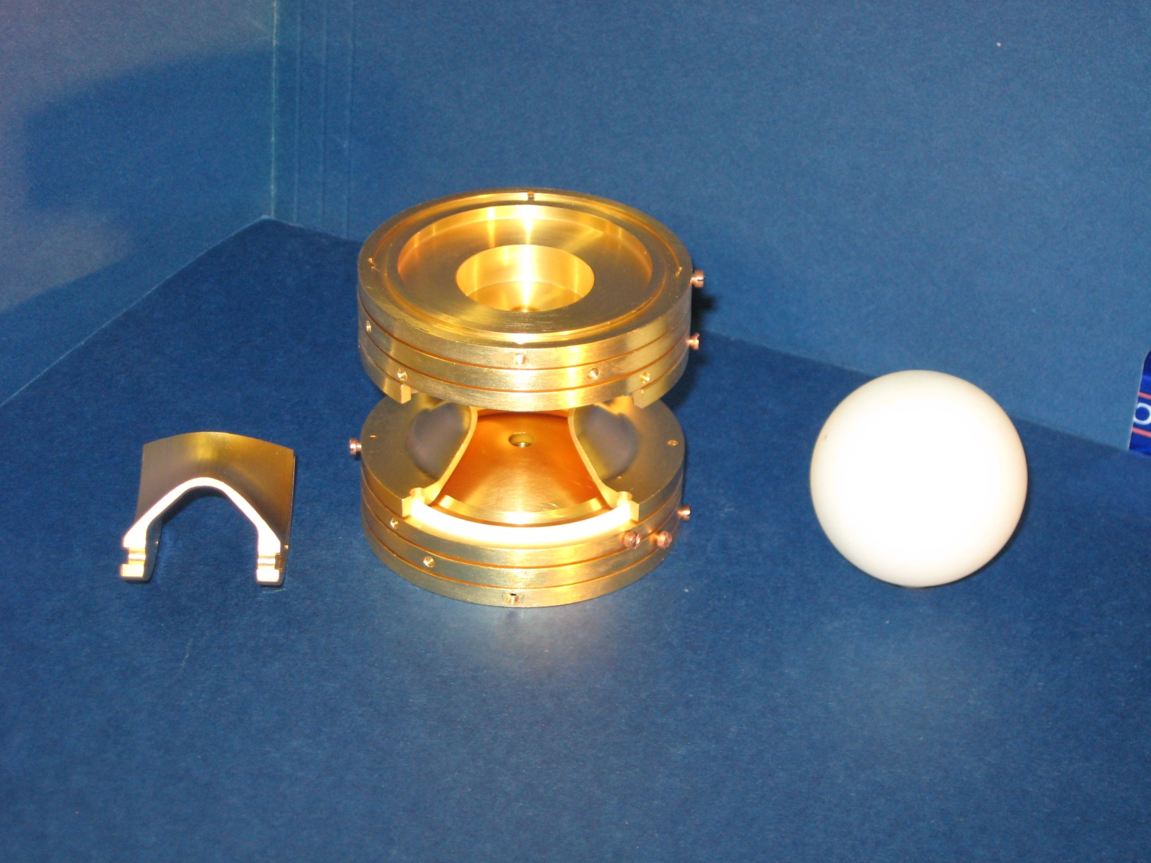
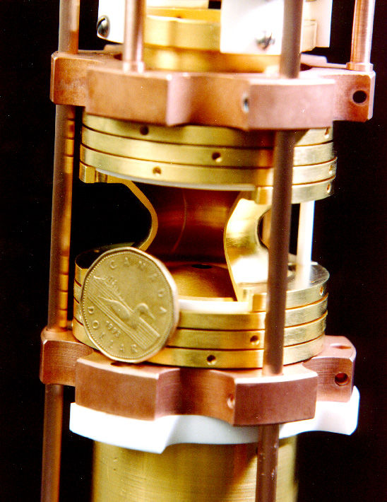
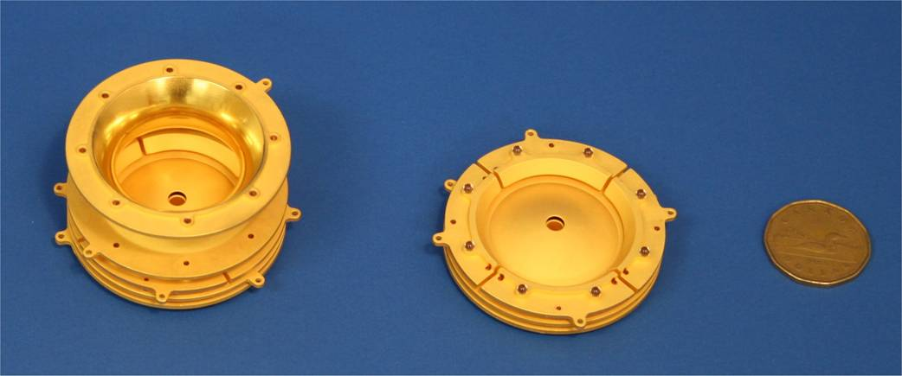
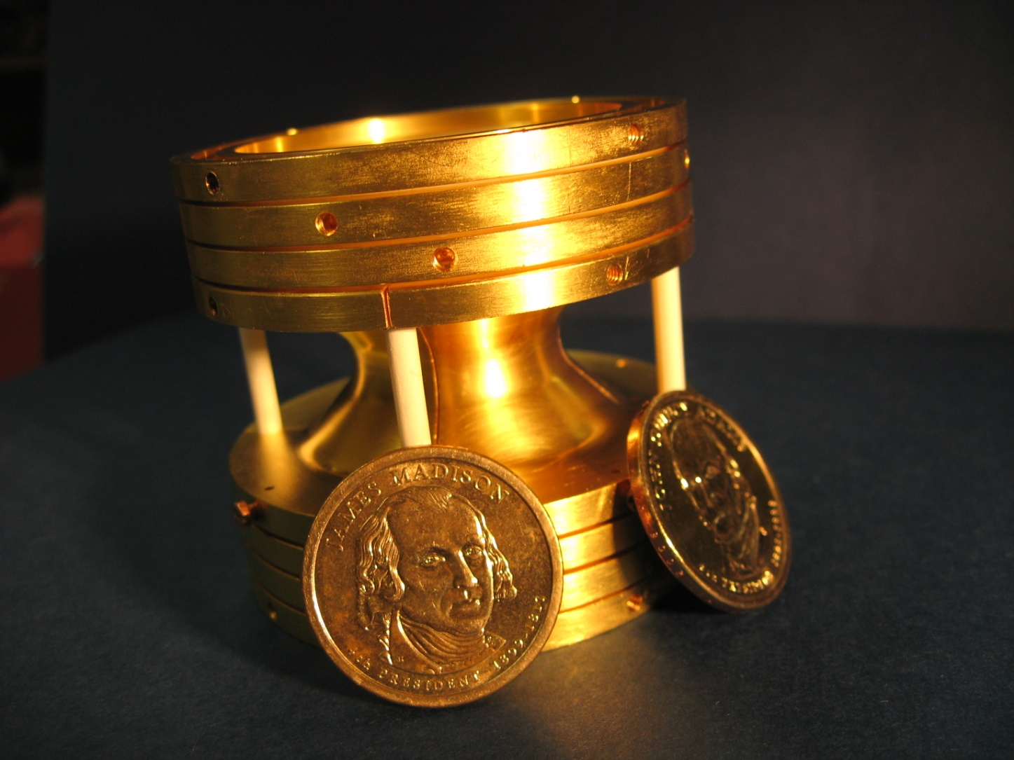
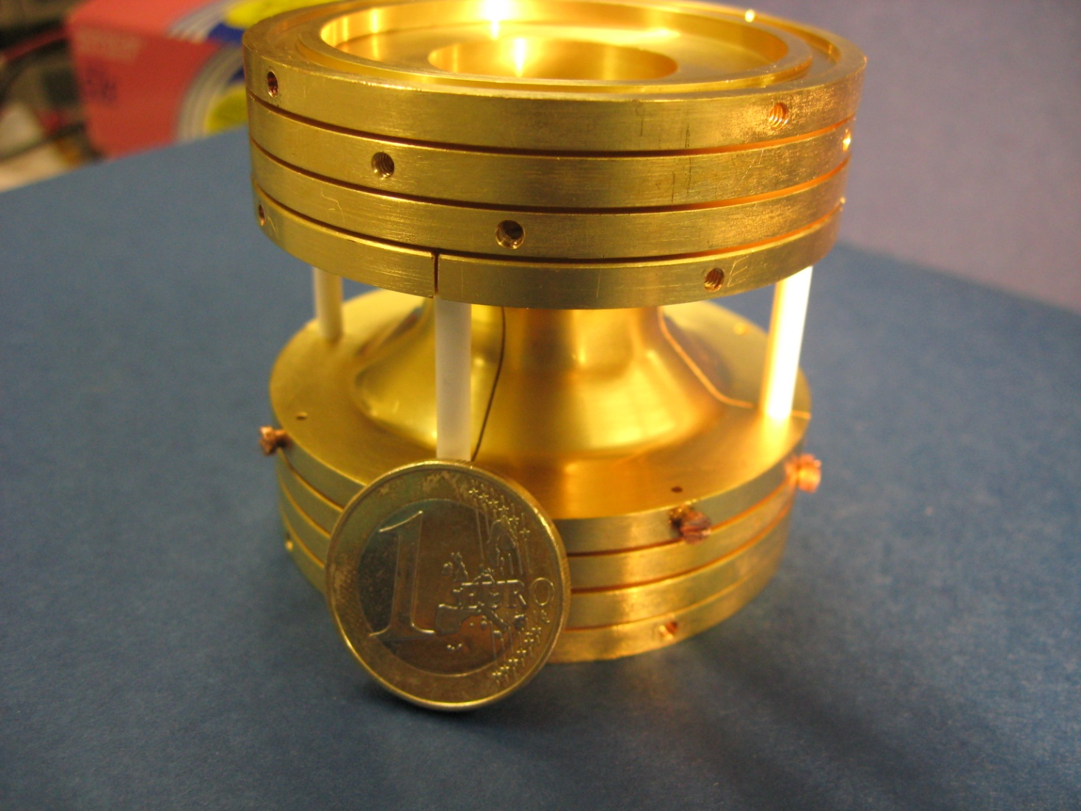
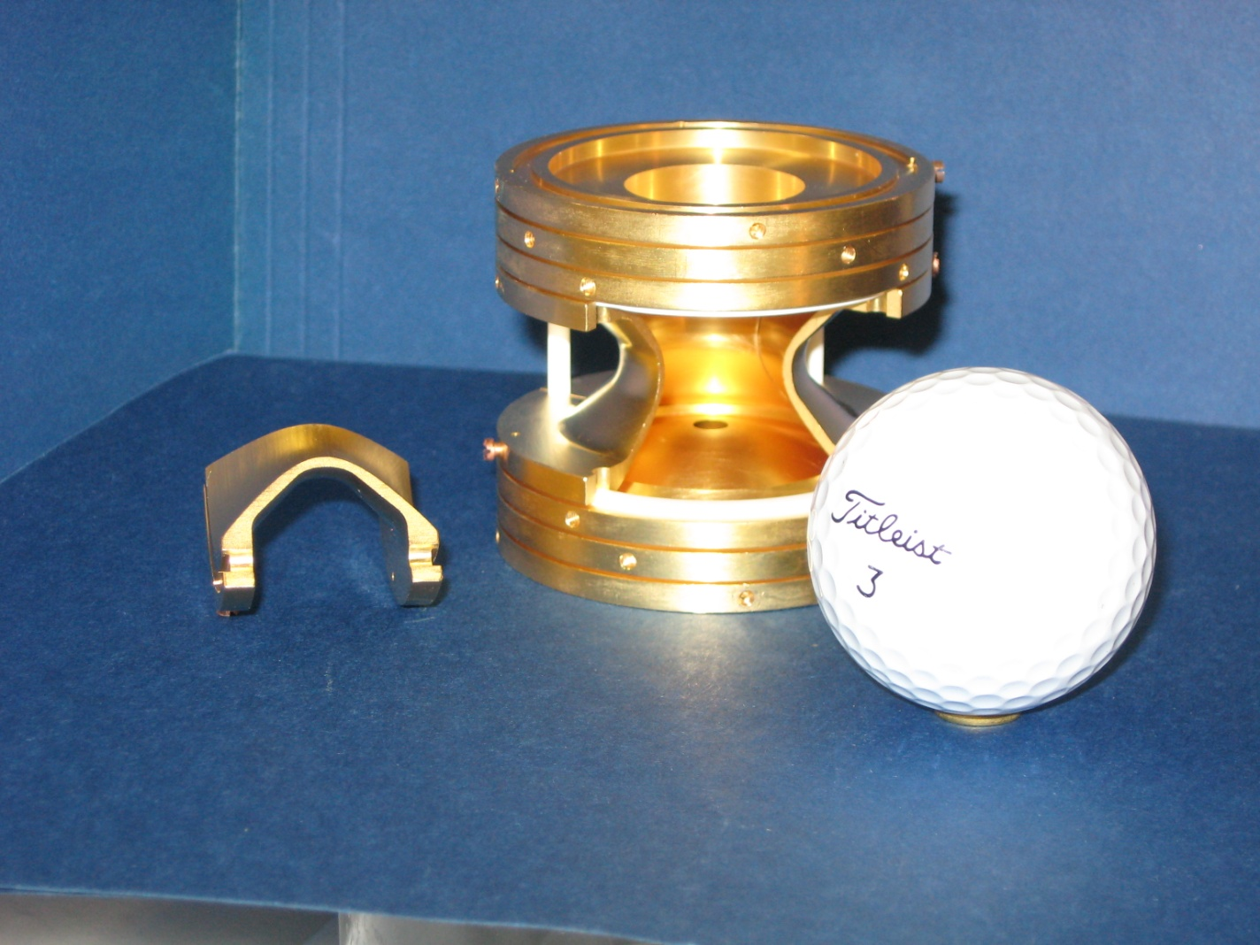
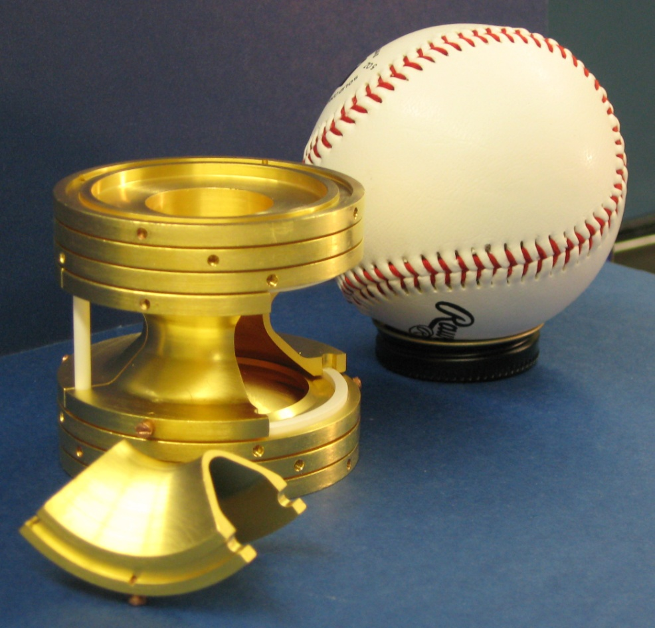
A Penning Trap
TITAN at TRIUMF
Electrodes create an axial quadrupole trapping potential
The potential repels in the radial direction but B takes care of that
Quadrupole potential created by making the electrodes conform to 2 hyperboloids of revolution.
Notes:
Point out that potential repels in the radial direction. It’s important later next slide.
Plus correction electrodes to account for finite extent of the hyperboloids and for the apertures.
Explain what a quadrupole potential is.
X² potential.
Simple harmonic oscillator
We know how to solve it

Slide 12
A Penning Trap
TITAN at TRIUMF
Electrodes create an axial quadrupole trapping potential
The potential repels in the radial direction but B takes care of that
Quadrupole potential created by making the electrodes conform to 2 hyperboloids of revolution.
The CPT at Argonne
Notes:
Point out that potential repels in the radial direction. It’s important later next slide.
Plus correction electrodes to account for finite extent of the hyperboloids and for the apertures.
Explain what a quadrupole potential is.
X² potential.
Simple harmonic oscillator
We know how to solve it

Slide 13
Notes:
Point out that potential repels in the radial direction. It’s important later next slide.
Plus correction electrodes to account for finite extent of the hyperboloids and for the apertures.
Explain what a quadrupole potential is.
X² potential.
Simple harmonic oscillator
We know how to solve it

Slide 14
Notes:
Point out that potential repels in the radial direction. It’s important later next slide.
Plus correction electrodes to account for finite extent of the hyperboloids and for the apertures.
Explain what a quadrupole potential is.
X² potential.
Simple harmonic oscillator
We know how to solve it

Slide 15
Trapping Ions
Ions are trapped in 3 dimensions
Now you can study them

Slide 16
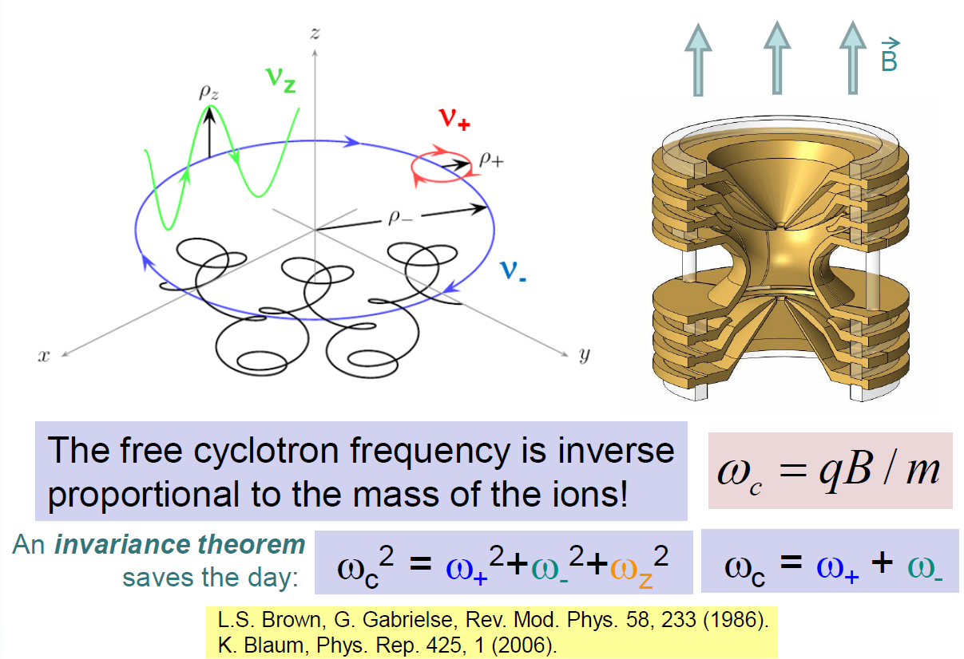
Storage of ions in a Penning trap
Notes:
Remind them that the potential repels
That splits wc into two motions.
Go through the slide image by image
Play the dipole and quadrupole movies

Slide 17
Energy Conversion
Channeltron
TOF
Detection
Linear
Energy
Magnetic field lines outside the Penning trap
Orbital
Energy
ω_{c} Excitation
Ions from the Penning trap
Notes:
We measure the energy by measuring the time of flight from the PT to a channeltron detector above the trap and outside of the magnetic field.
We need to know how much energy we’ve put into the system so we need to convert the orbital energy to linear energy.

Slide 18
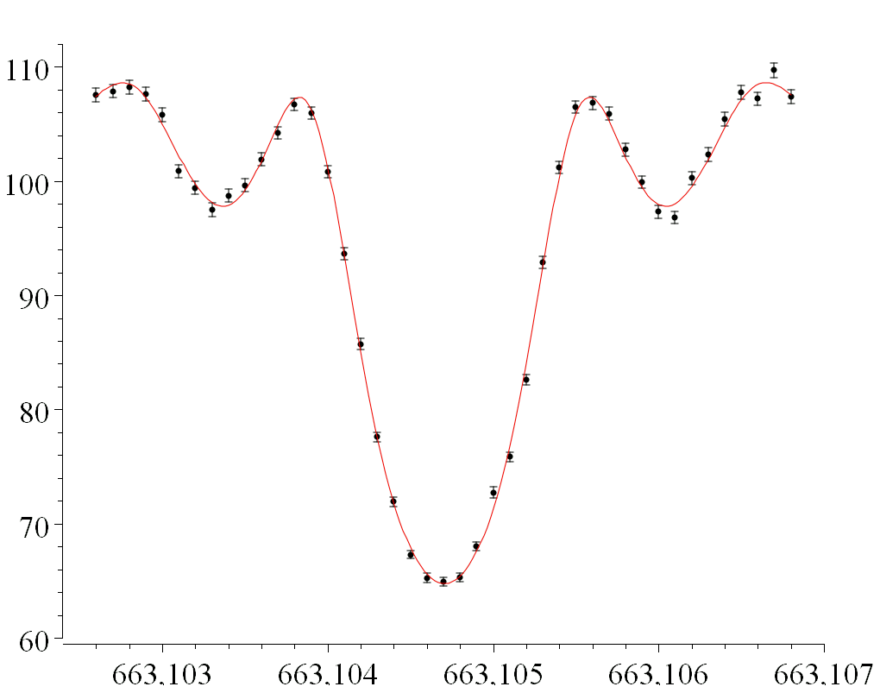
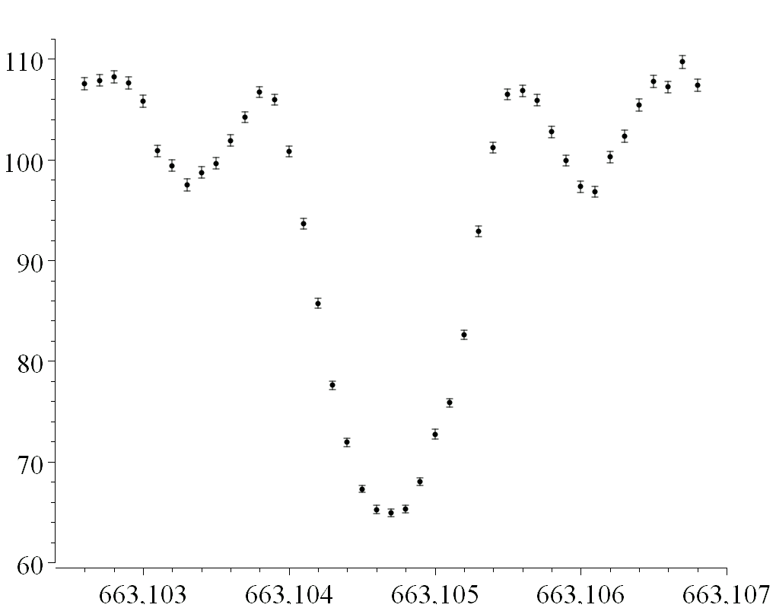
Sample ToF Spectrum
¹³³Cs
Time of Flight (arb units)
Unknown:
Frequency (kHz)
Slide courtesy of J. Van Schelt
Notes:
133Cs was chosen because it is close in mass to what we were measuring and because it’s precision is dm/m = 1.7 E-10.
Click early: trf is the amount of time that the excitation has been applied for

Slide 19
Sample ToF Spectrum
¹³³Cs
Time of Flight (arb units)
For 1 s excitation, Width ~1Hz = Δν
Δm ≈ 200 keV/c²
Unknown:
f_{c}=663,104.706(3) Hz (560 eV/c²)
Frequency (kHz)
Slide courtesy of J. Van Schelt
Notes:
133Cs was chosen because it is close in mass to what we were measuring and because it’s precision is dm/m = 1.7 E-10.
Click early: trf is the amount of time that the excitation has been applied for

Slide 20
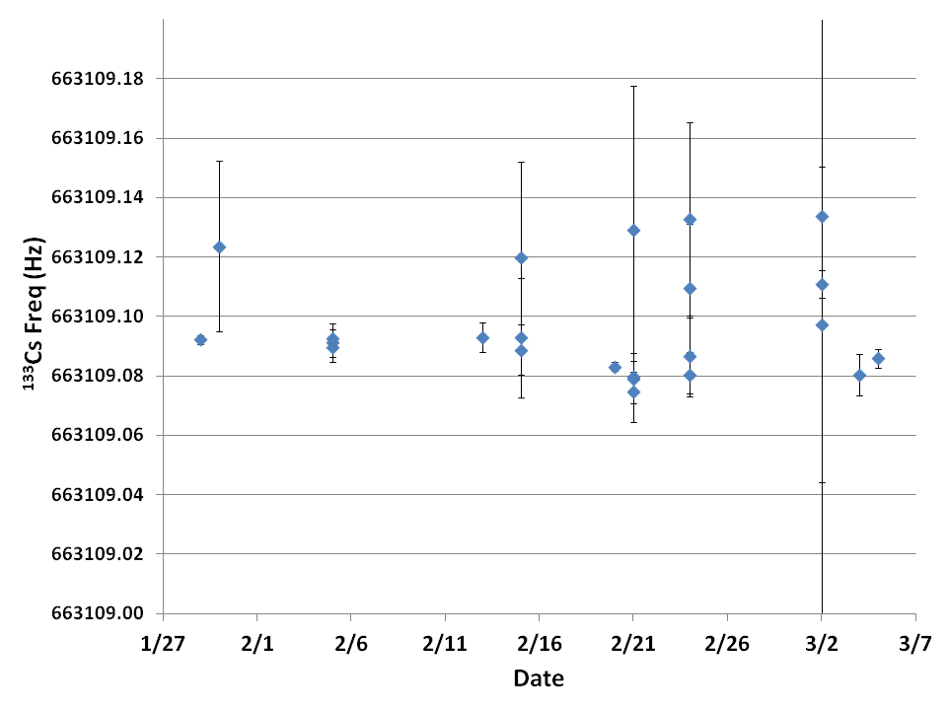
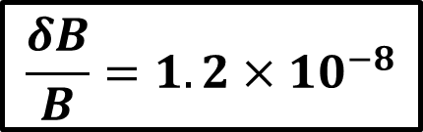
System Stability
663,109.086(8) Hz
$$\frac{δB}{B}=1.2×{10}^{−8}$$
Notes:
We monitor drifts in the system by measuring a calibrant ion over time.
Drifts can be due to B field, E field, pressure
In general, we measured before we’re about to perform a set of measurement, at the end of a set (could be many days later) and any time there is a foreseeable stoppage so we can switch between sources.
We noticed drift over the course of the measurements that weren’t uniform. Because of that we chose to use a central value with an added systematic uncertainty of ~11 ppb

Slide 21
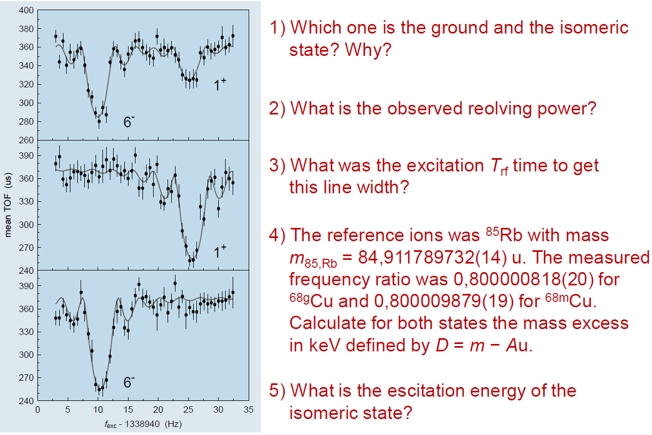
Questions – In class then homework

Slide 22
Larger image for your convenience

